Slide 1
Blockchain Programming
Dr. Adnan IMERI Technical Lead, INFRACHAIN and Luxembourg Blockchain Lab (LBL)
Disclaimer: This training intends explanation of technological advancements, and it does not intend any financial advice toward cryptocurrency or any digital asset!

Slide 2
Practical Information
Course Objective
To give a broad intro to BC prog. and guide the audience through first hands-on Smart Contract and Decentralized Application
Course Organization
17:30 - 19:30 PM, via Teams (Online only)
9 Sessions
Learning Outcomes
Introduction to Blockchain
Concepts
Programming
Tools
DApp and Web3
Resources:
Team Post
Literature suggested during the course
Contact
Send me an email: adnan.imeri@infrachain.com

Slide 3
Practical Information
Getting Familiar with Working Environment
Teams
Virtual Machines
Self-Working Environment

Slide 4
Dev Stack for blockchain programming
Install Node.js:
https://nodejs.org/en/download/
1
Install Visual Studio Code: https://code.visualstudio.com/download
2
Verify node version :
node –version
3
Create a new project from Visual Studio Code
4
npm init: To create package.json file
npm install: To install full node nodules

Slide 5
Table of Content (Session 1)
Technology Perspective
Distributed Ledger Technologies
Blockchain Technology
Blockchain Technology Components
Node
Network
Architecture
PKI Infrastructure
Hashing
Accounts
Transactions
Consensus
Data structure
Block
Smart Contract

Slide 6
Technology Perspective
Centralized
Decentralized
Decentralized-Distributed

Slide 7
Centralized: Client-Server Architectures
Client-server (CS) architecture comprises two software processing sides: server-side and client-side.
The client-side allows users to query formalization, send a query on the server-side, and receive a response (query result) from the server-side.
The server-side stores and manages user data, processing application data, and user queries.
Advantages:
Scalable
Mature technology
Accessible (easy programmable)
Disadvantages:
Single point of failure
Trust and Transparency issues.
data loss, data altering, and data integrity.
Expensive to setup and maintain

Slide 8
Distributed
Cloud Computing (CP)
Enabled moving from client-server into distributed architectures (remote operation system, software, hardware)
Software as a Service (SaaS)
Infrastructure as a Service (IaaS)
Application as a Service (AaaS)
…
Internet of Things (IoT)
IoT describes a set of devices that are able to collect, exchange, and share information
IoT
Cloud Computing

Slide 9
Decentralized-Distributed
No centralized authority to maintain information
Peer-to-peer communication protocol
Network of nodes (computers/servers/low power devices)
Same copy of data in all nodes
Consensus algorithm

Slide 10
In Nutshell
Image source: Link

Slide 11
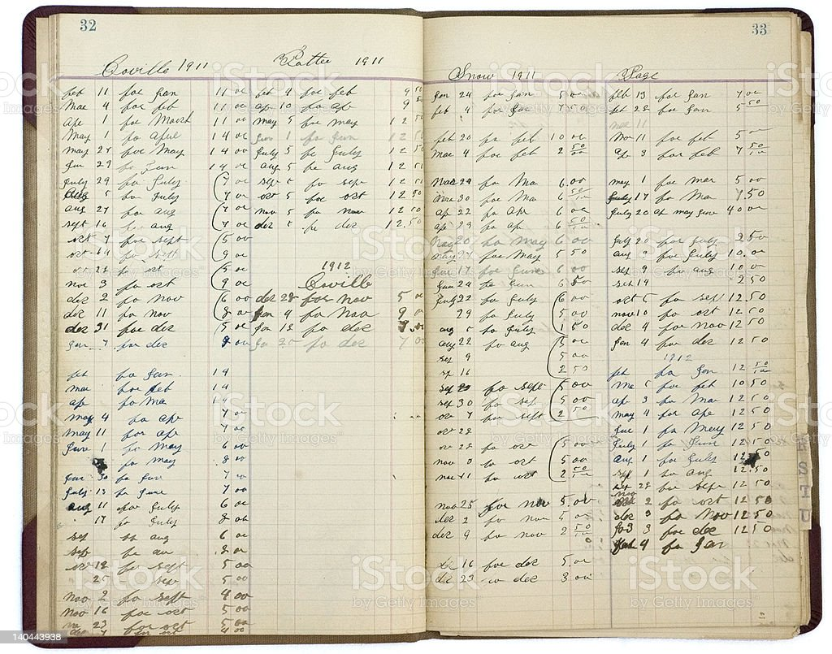
Distributed Ledger Technologies
Ledgers
“Ledgers have existed since ancient times and have served as record-keeping of transactions” [1]
a pen and paper ledger
a large database maintained by a central authority e.g., Banks
“Distributed ledger technology (DLT) presents a distributed and decentralized database, shared among multiples parties, known as network participants”
Blockchain
BC technology is an instance of the distributed ledger

Slide 12

Blockchain
Blockchain (BC) is a distributed decentralized database that allows storing immutable cryptographically signed transaction data.
Transaction data are gathered into blocks and chained together with the previous block, thus forming a blockchain.
Example:
Bitcoin: https://www.blockchain.com/btc/blocks?page=1
Ethereum: https://etherscan.io/blocks

Slide 13
Blockchain Technology Components
Image source [1]

Slide 14
Blockchain Technology Components
Blockchain Network
Composed of several nodes that are distributed geographically
Peer-to-Peer communication
Rely on consensus algorithms
No central node/cluster/cloud
Nodes
Computer/Servers that store and maintain the distributed ledger
Network Visualization: https://bitnodes.io/nodes/network-map/
https://dailyblockchain.github.io/
https://mempool.space/
Source: https://news.bitcoin.com/18-visualizations-bitcoin-network/

Slide 15
Blockchain Technology Components
Hashing
Cryptographic hash is a one-way function that yields a fixed-length string for the given input.
has256(blockchain) → ef7797e13d3a75526946a3bcf00daec9fc9c9c4d51ddc7cc5df888f74dd434d1
Working with hash: /dev/Hashing.js
Addresses in the blockchain:
Is derived from their public key + auxiliary data by using the hash function over it!
Types of Addresses:
User address (Wallet)
Smart Contract address
Source: https://www.geeksforgeeks.org/passwords-and-cryptographic-hash-function/
Hash Generator: https://passwordsgenerator.net/sha256-hash-generator/

Slide 16
Blockchain Technology Components
Transaction
Any interaction/action in blockchain is done through transaction
Explore transactions
Timestamp: The time when the block/the transaction
is executed (mined)

Slide 17
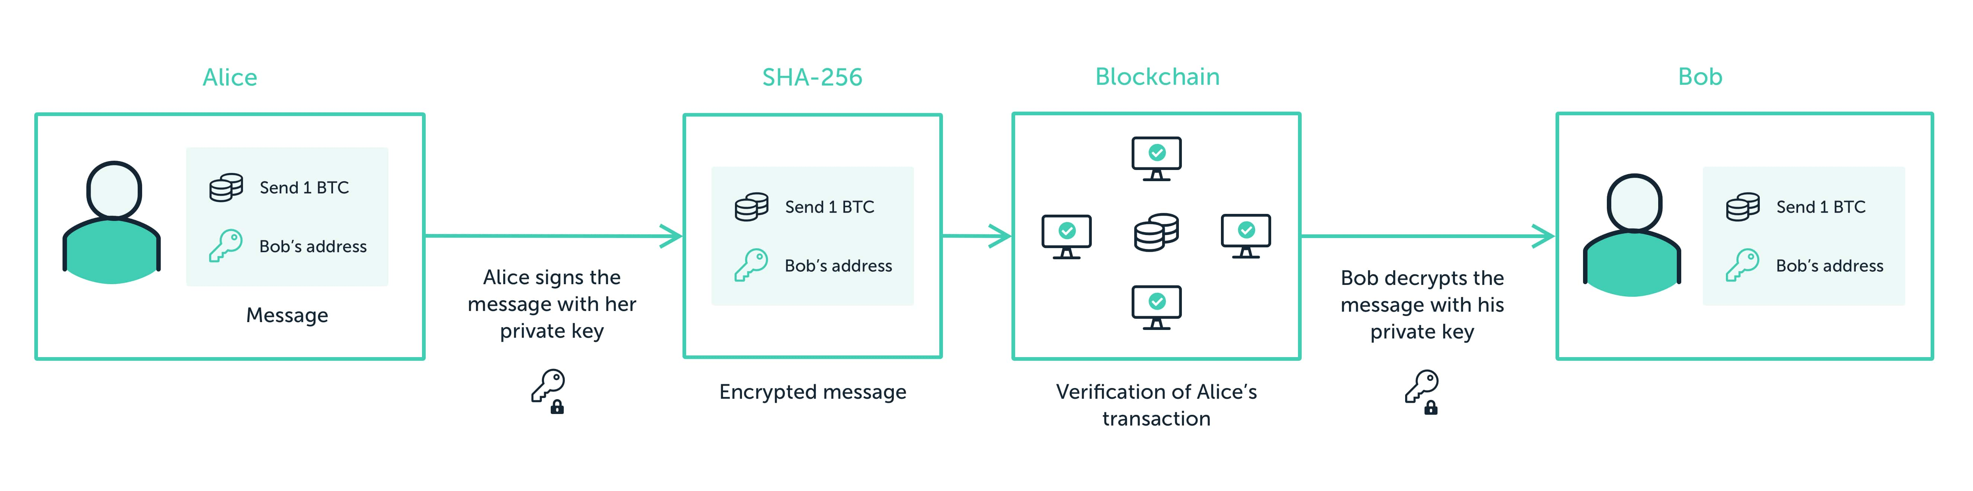
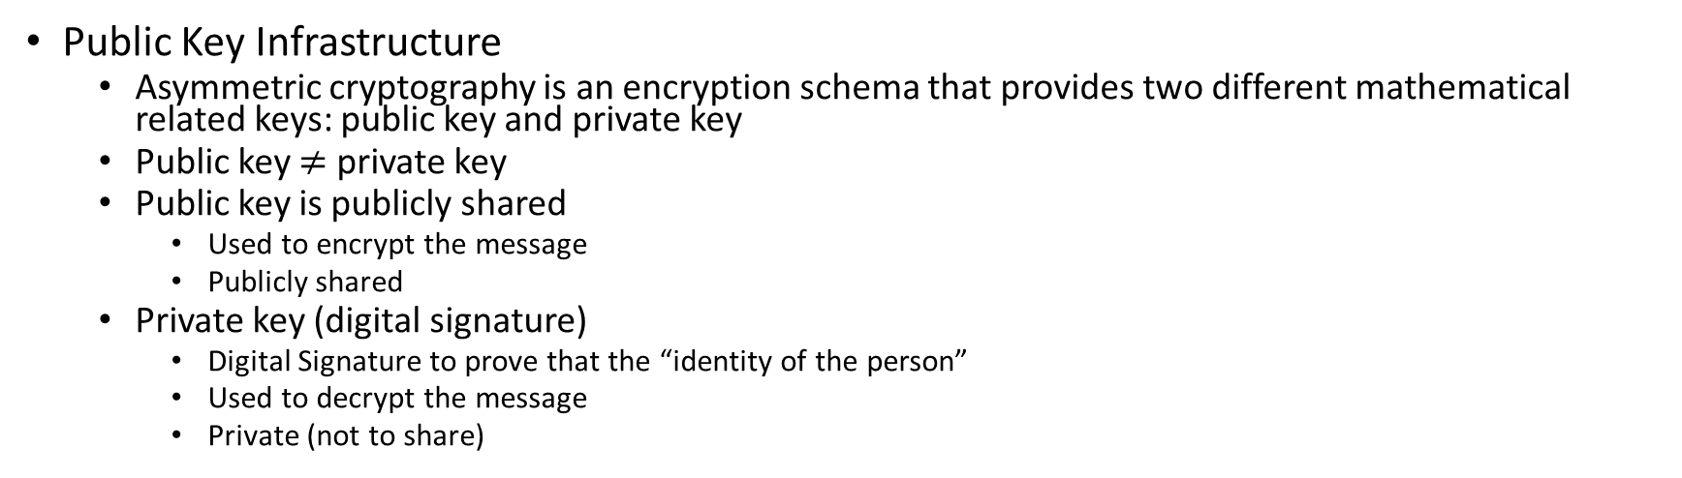
Digital Signature
Public Key Infrastructure
Asymmetric cryptography is an encryption schema that provides two different mathematical related keys: public key and private key
Public key $≠$ private key
Public key is publicly shared
Used to encrypt the message
Publicly shared
Private key (digital signature)
Digital Signature to prove that the “identity of the person”
Used to decrypt the message
Private (not to share)
Image source [3]

Slide 18
Digital Signature
In the blockchain, Digital Signature is fundamental and used to authenticate transactions. At any time when the user submits transactions, they must prove to every node in the system that they are authorized to spend those funds [5]. Public-private key generation
/dev/PKIGen.js
Example: Encrypt and decrypt text using Public-key cryptography
/dsev/EncryptDecrypt.js

Slide 19
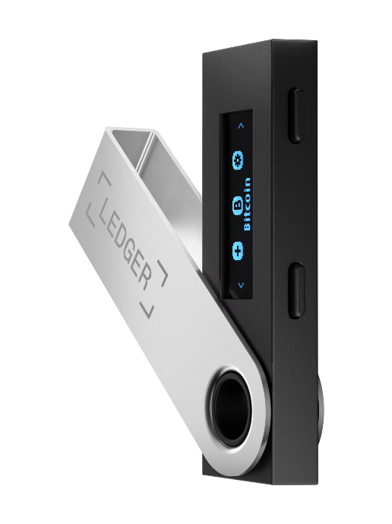
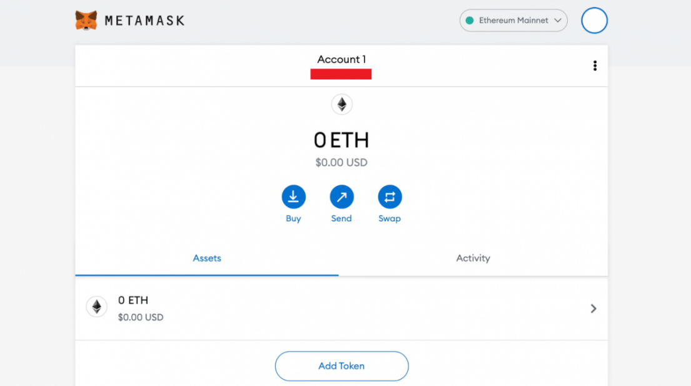
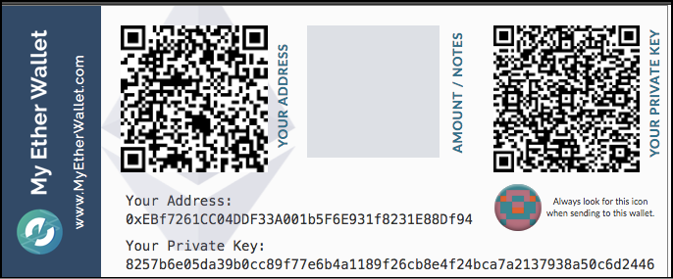
Wallets
Public and Private Key long “string” and hard to keep in mind
Wallets:
Software packages that securely store private, public, and other related addresses
Wallet types
Hot Wallet
Cold Wallet
Paper-based wallet

Slide 20
Blockchain Technology Components
Block
Header
Hash of the previous block header
Hash of the current block
Timestamp
Cryptographic nonce
Merkle root
Body
Transactions
Example:
Bitcoin: https://www.blockchain.com/btc/blocks?page=1
Ethereum: https://etherscan.io/blocks
Source: https://www.geeksforgeeks.org/blockchain-merkle-trees/

Slide 21
Blockchain Technology Components
Markel Tree
Crucial role in verifying the integrity of transactions stored on the blockchain
Modifying information in one node is denied once comparing hashes in Merkle Tree
How Merkle Tree works?
Image source [1]

Slide 22
Blockchain Technology Components
Mining/Baking: The process of adding a new block to the chain is called mining (or baking).
Miners are powerful computers that compete to solve a cryptographic puzzle, to mine a block
Miners (winner) gets a reward for adding a new block
More mines → Stable network

Slide 23
Blockchain Technology Components
Consensus:
Many nodes/computers agree on the state (pieces of information) of data
Maintain the state of the distributed-decentralized ledger
In case some nodes try to modify data in their local ledger, consensus compares this data with N other nodes and denies changes → Data Integrity!
Types of Consensus:
Proof of Works
Proof of Stake
Proof of Authority
Etc.
Image source [3]

Slide 24
Smart Contract
Smart Contract is a computer code that is deployed on the blockchain and is triggered once some conditions are fulfilled
Programmability of Smart Contract
Structure
Name/Address
Methods (functions)
Programming Languages
Solidity
JavaScript/Typescript
Java
Kotlin
Rust
Etc.

Slide 25
Benefits of using Blockchain Technology
Trust and Transparency
Data Security
Data Immutability
Auditability/Timestamped
Smart Contracts (SC)

Slide 26
Blockchain Technology Components
Install
Wallet Meta Mask
Get some eth (Sopholia)
https://cloud.google.com/application/web3/faucet/ethereum/sepolia
https://faucet.egorfine.com/
Explore Remix:
https://remix.ethereum.org/
Deploy simple SC
pragma solidity ^0.5.0;
contract FistSmartContract {
constructor() public{ }
function getResult() public view returns(uint) {
uint x = 1; uint y = 2;
uint result = x + y;
return result;
}
}

Slide 27
References
[1] Imeri, Adnan. Using the Blockchain Technology for Trust Improvement of Processes in Logistics and Transportation. Diss. University of Luxembourg,​ Esch-sur-Alzette,​​ Luxembourg, 2021.
[2] Public-key Cryptography: https://www.ledger.com/academy/blockchain/what-are-public-keys-and-private-keys
[3] Proof of Work: https://www.ledger.com/academy/blockchain/what-is-proof-of-work/
[4] https://www.sohamkamani.com/nodejs/rsa-encryption/
[5] https://www.coinbase.com/cloud/discover/dev-foundations/digital-signatures

